Slide 1

A FIVE A SIDE FOOTBALL MANAGEMENT SYSTEM
A PROJECT BY BILYAMINU SULEIMAN
(161203003)

Slide 2
ABSTRACT
The sport industry is one of the fastest growing industries around the globe with football at the heart of the industry. Football happens to be the most popular sport in the world, with more than 3 billion people investing their time and money to view the sport. The sport is also enjoyed by individuals who physically play it, it serves as a form of escape and leisure to billions of people around the world.
The football industry however like every other industry has taken advantage of the provision of technology to further spread its wings.
It is however obvious though that technology has not been able to touch every aspect of the
sport, and still presents limitations and more room for improvements. This project will focus on one of such limitations and provide a key solution for lovers of the sport, who prefer to engage in it physically

Slide 3
BACKGROUND OF STUDY
Football has a long history. Football in its current form started in England in the 19th century. but alternative forms of the sport existed earlier and are a major part of the sport history.
Five-a-side football is a fast moving game that is often played amongst friends, partly because of the ease of finding five players for a team. Pub teams, work colleagues and friends.
This project seeks to leverage on some technological advancements to offer a more suitable means for football lovers in creating an enabling environment in the management system of five-a-side Football pitch without the need to search endlessly for a five-a-side pitch.
The main aim of this web app is to ensure that individuals have an effective and organized way of managing their football affairs while at the same time achieving the objective of making information about five-a-side football activities always available.

Slide 4
STATEMENT OF PROBLEM
Football could sometimes be tedious when it comes to rallying individuals and searching for a pitch to be used, which often most times results in loss of interest.
This project looks at using a series of research of the sport and reviews of people to offer an improved and convenient means of selecting and finding players, creating and organizing tournaments as well as locating a pitch nearest to football in a specific region, town, state, or country.

Slide 5
AIM
The aim of this research is to develop a suitable web app that will be focused on providing support to individuals in need of a location/pitch to play football, as well as an easier way to manage the gathering of teams ready to play local tournaments in their location.

Slide 6
OBJECTIVES
To create a system that provides footballers with the nearest five-a-side pitch in their location.
To provide an improved and convenient means of registering teams and player details.
To create a system where team owners can view match stats and fixtures.
To establish an online system which will be available anytime and anywhere.

Slide 7
SCOPE
This project will be focused on the development of a web-based app centered around helping footballers in Abuja, and consequently Nigeria to locate five-a-side pitches.

Slide 8
LIMITATION
This system however will not implement a method of selecting and matchmaking of the individuals into various teams of fives during the match.
This system is also going to be limited to people that have access to computers, internet devices and smart phones.

Slide 9
BENEFITS OF FIVE-A-SIDE TO GO.
Ease of finding suitable venues(pitch).
Ease of finding players with interest.
Ease of managing league or tournament activities.

Slide 10
LITERATURE REVIEW
Five A side a football management system: A system designed by Jovan Marinkovic in 2020 was besieged with some challenges such as not providing a satisfactory user experience, thus, leading to lack of interest from users. This however suggested that a methodology not allowing for revisiting of previous stages was used, such as waterfall. This project looks at making more than just a five-A-side game but rather a live web app that helps find locations of various football pitches round the globe, a methodology that allows for flexibility and addition of user inputs will be implemented.
Ezfacility: A sports management system in the U.K with the aim of providing rich management software for the sports and fitness industries within the UK, they’ve provided clients with a responsive design and secure platform where they can manage five-a-side centers anywhere from any device, create leagues and manage user membership and attendance

Slide 11
METHODOLOGY
WATERFALL WITH BACKTRACKING.
Before the next phase of development, each phase must be completed.
Best used for smaller projects where requirements are well defined.
Performs quality assurance test (verification and validation) before completing each stage.
Elaborate documentation is done at every stage of the software’s development cycle.
Project is completely dependent on the project team with minimum user intervention.
Any changes required are done during the software development.

Slide 12
REQUIREMENTS
TEAM OWNER REQUIREMENTS
Register.
Login.
Register team and players.
See available tournaments.
See fixtures and results.

Slide 13
REQUIREMENTS(CONT’D)
SYSTEM REQUIREMENTS
A PC with a windows operating system from 7 to 10.
A windows or Unix based computer with at least 2gb RAM.
A web browser, preferably chrome.
An active internet connection.

Slide 14
TOOLS AND LANGUAGES USED
Bootstrap CSS (cascading style sheet)
JavaScript
PHP (hypertext-preprocessor)
Xampp local web server
MySQL database sever
Laravel
Visual studio code

Slide 15
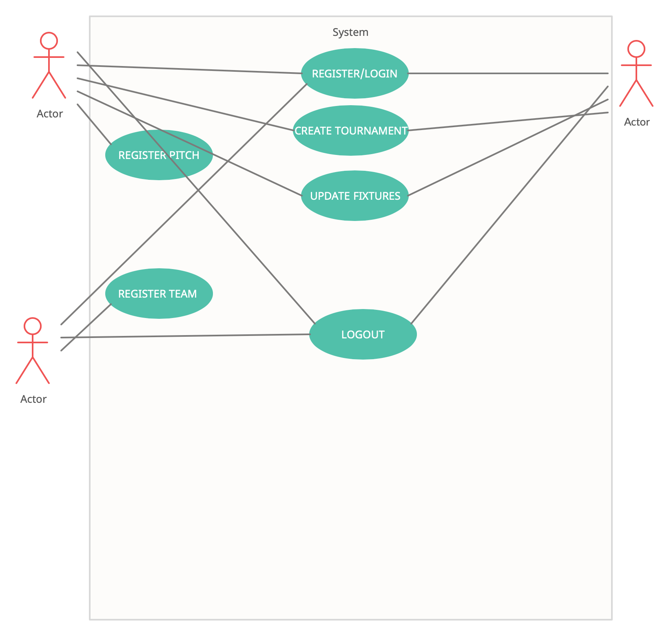
UML DIAGRAMS
USECASE DIAGRAM

Slide 16
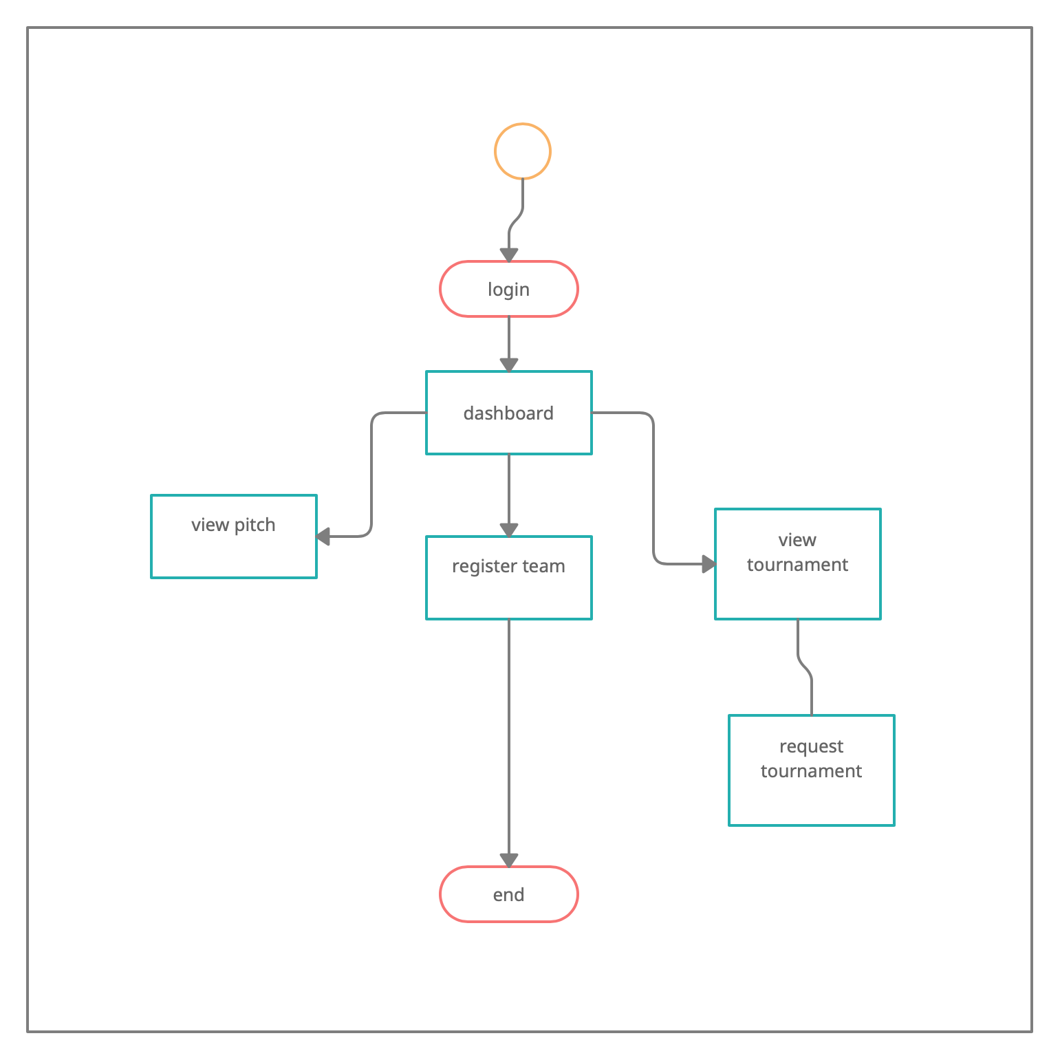
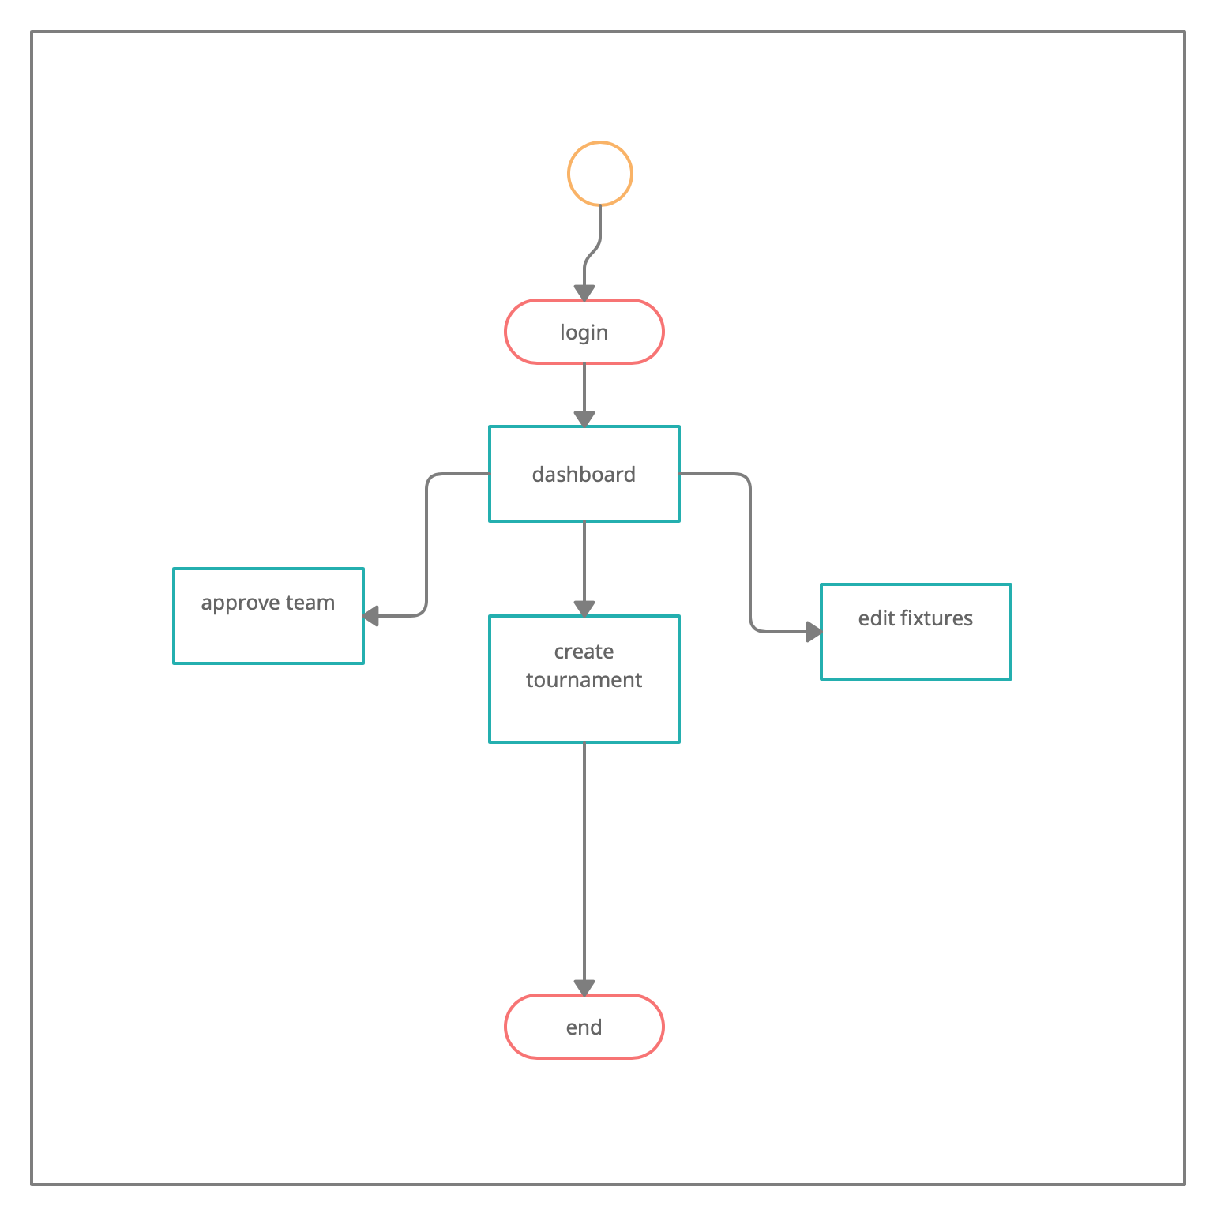
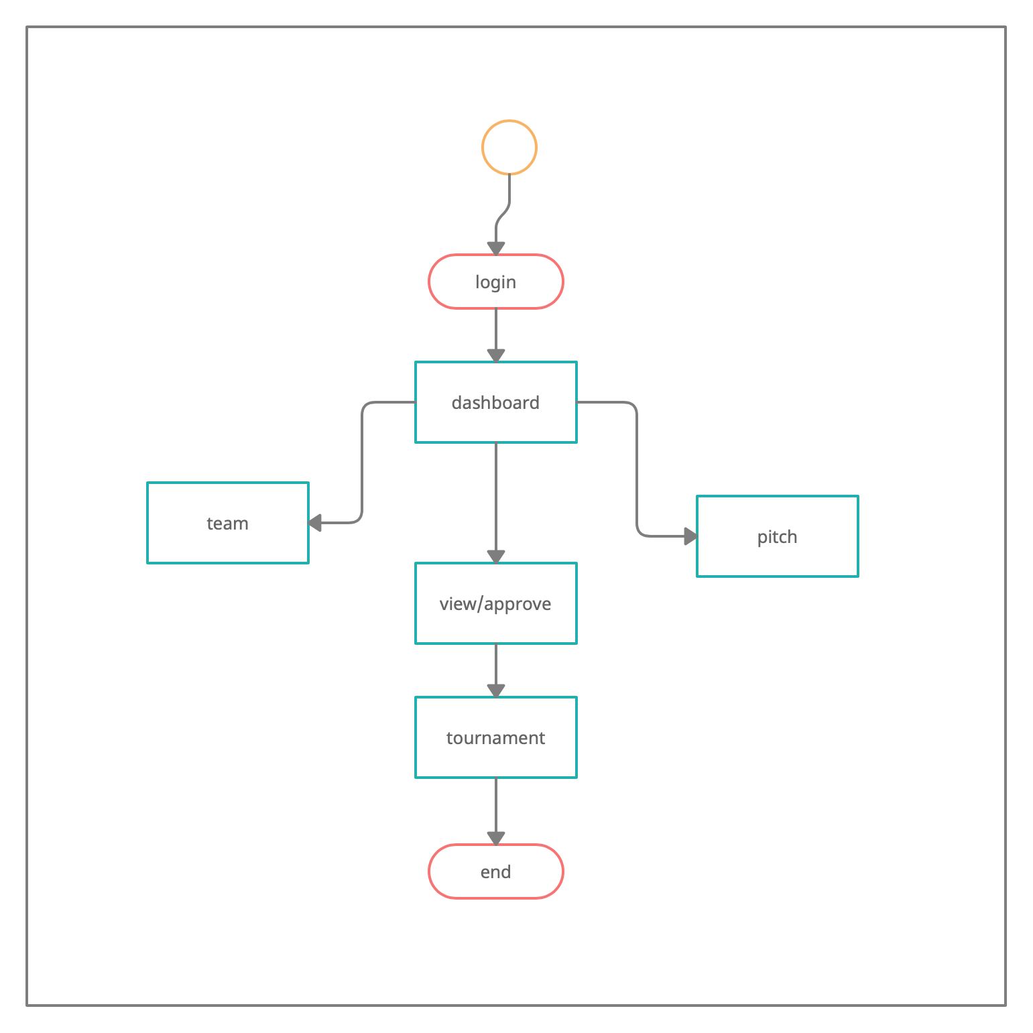
UML DIAGRAMS
ACTIVITY DIAGRAMS

Slide 17
INPUT OF CORE FUNCTION
The core functions of the system which was implemented include the following:
Admin and Team manager registration.
Admin and Team maanager login/logout function.
Creating tournaments and updating match results.
Viewing team and player details.

Slide 18
RECOMMENDATION
Future works can endeavor to add a method of helping players start leagues or tournaments and help keep track of score lines and player stats, as well as a means of inputting suggestions and communications between player to player.

Slide 19
CONCLUSION
In conclusion we sincerely hope that Nigerians will find the web app beneficial in helping them get conducive locations to meet other people and play football, and would have made the method of searching for a five-a-side pitch easier while also reducing stress and cost.

Slide 20
REFERENCES
u. games, "uber games (quality garden games and indoor games).," [Online]. Available: http://www.ubergames.co.uk.
j. marinkovic, "Football Game Management System Redesign," [Online]. Available: http://www.jovanmarinkovic.com/fiveaside.
toepoke, "toepoke," [Online]. Available: https://toepoke.co.uk/home.aspx.
j. t. point, "javatpoint," [Online]. Available: https://www.javatpoint.com/jira-waterfall-model.
p. manager, "project manager," [Online]. Available: https://www.projectmanager.com/waterfall-methodology.
s. reddy, "medium," [Online]. Available: https://medium.com/@sudarhtc/waterfall-methodology-in-project-management-phases-benefits-85393be2f1d.
tutorialspoint, "tutorials point," [Online]. Available: https://www.tutorialspoint.com/sdlc/sdlc_software_prototyping.htm.
guru99, "guru99," [Online]. Available: https://www.guru99.com/software-engineering-prototyping-model.html.
project community, "project community," [Online]. Available: http://projectcommunityonline.com/waterfall-project-management-an-overview.html.
tallyfy, "tallyfy," [Online]. Available: https://tallyfy.com/uml-diagram/.

Slide 21
THANK YOU!!
AND GOD BLESS NIGERIA!

